Slide 1
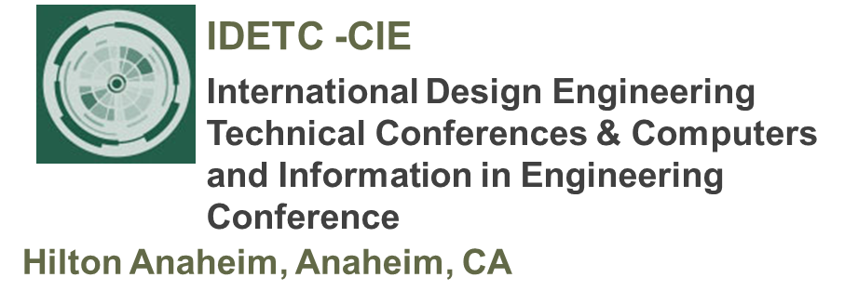

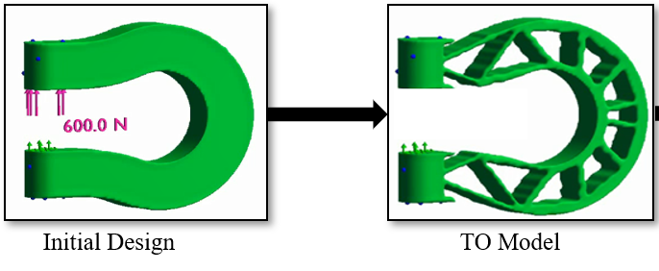
Tutorial 1
Learning Topology Optimization Through Examples and Case Studies
August 18, 2019

Slide 2
TopOpt
Objective?
Constraints?
Method?
Ku = f
Compliance J = f^{T}u
Compliance = 1/Stiffness

Slide 3
Classic TO Problem
Minimize Compliance
Volume Constraint
Ku = f
Minimize J
Vol.Frac ≤ 0.5
Mathematics is easiest!

Slide 4
Current TO Strategies
Minimize J
Vol.Frac ≤ 0.5
Ku = f
TO Strategies
Homogenization
SIMP
Level-Set
Evolutionary

Slide 5



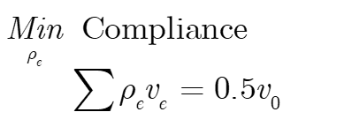
SIMP
SIMP: Solid Isotropic Material with Penalization

Slide 6
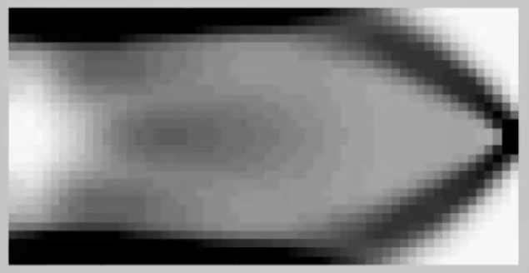
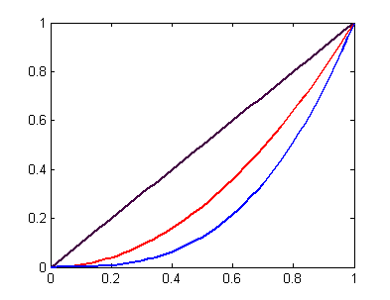
SIMP: Key Concept
Material dependence on pseudo-density
p~3: Penalize intermediate densities

Slide 7




SIMP: Choice of p
p = 1; C = 184
p = 1.5; C = 210
p = 2; C = 220
p = 3; C = 229
[“Engineering Optimization”; TU Delft]

Slide 8
SIMP: Optimization Method
Sequential Quadratic/Linear Programming
Method of Moving Asymptotes
Optimality Criteria
Discussed in text

Slide 9
SIMP
MATLAB Demo

